Slide 1
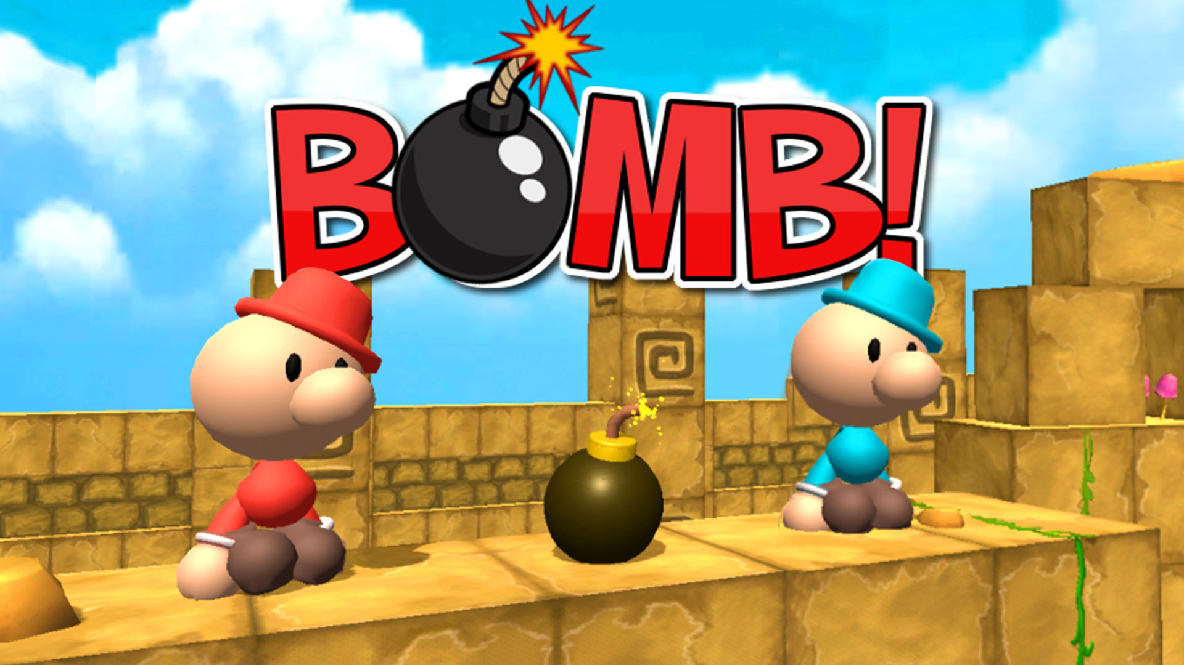
WELCOME!!

Slide 2
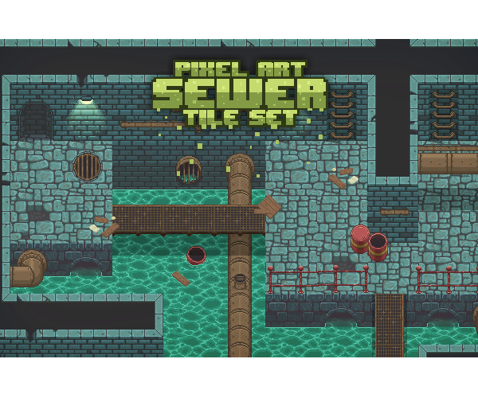
PROJECT PRESENTATION
Trịnh Quang Anh ITITIU19002
Lê Trần Phong ITITIU19180
Nguyễn Ngọc Minh Nhật ITITIU19172

Slide 3
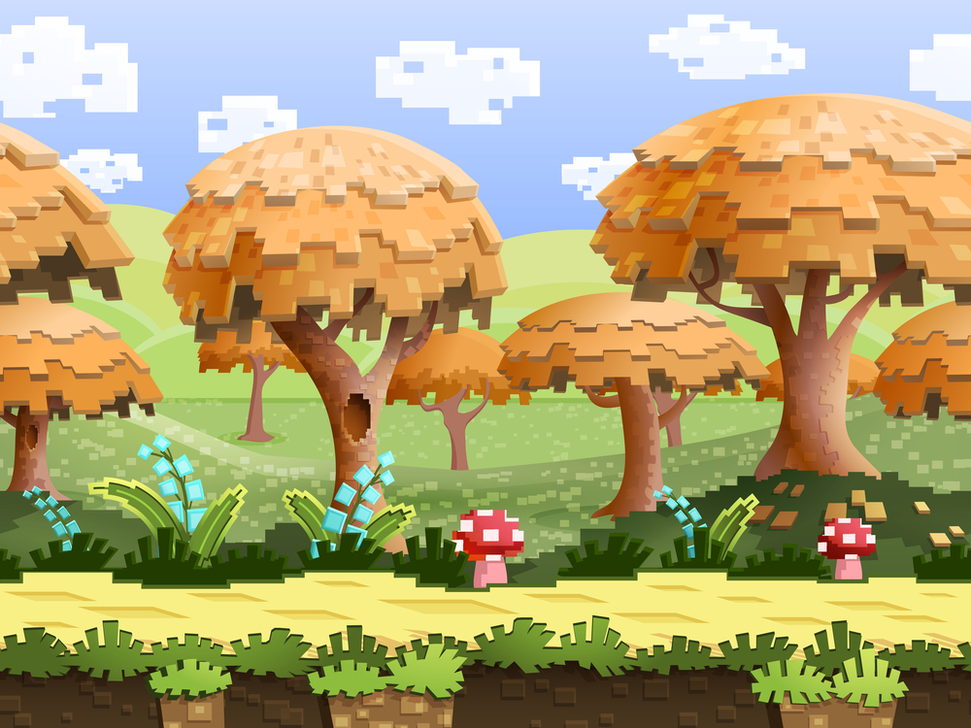
OUTLINE
1. Game rules
2. Features and Mechanisms
3. Path-Finding Applying Dijsktra
4.Design Patterns, Future Updates

Slide 4
GAME RULES
1

Slide 5
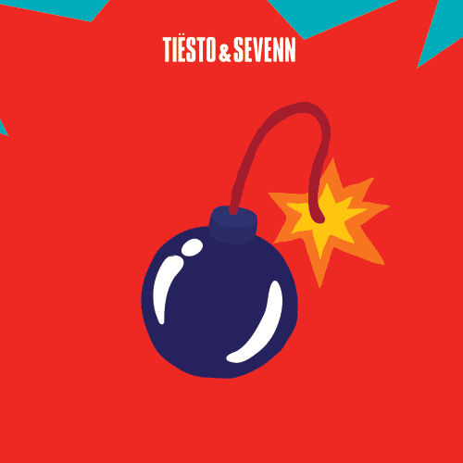
GAME RULES
1. Moving characters to place bomb 💣
2. Kill the monsters before they try to kill you 🎃
3. Getting items to get stronger

Slide 6
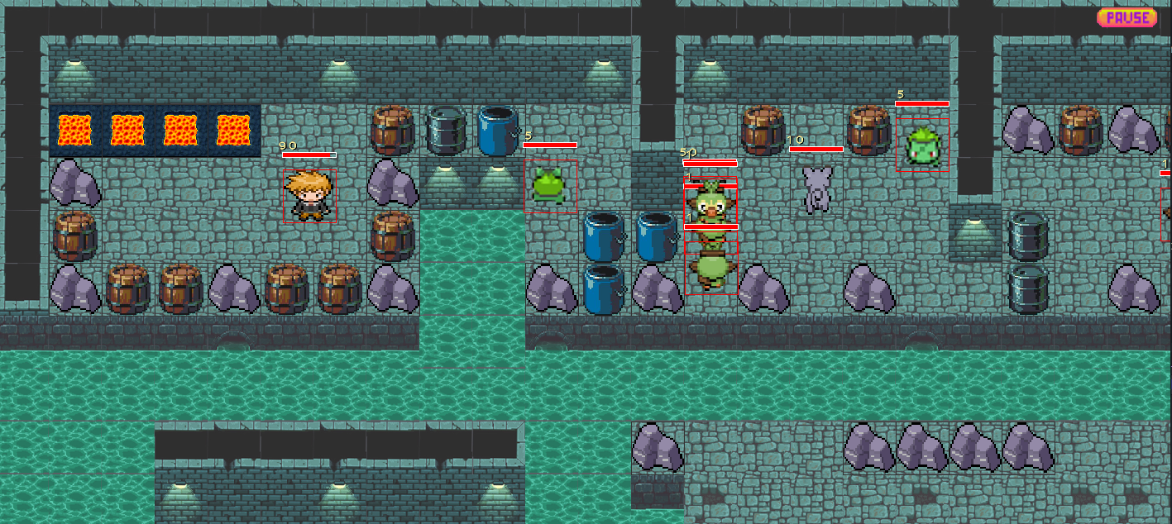
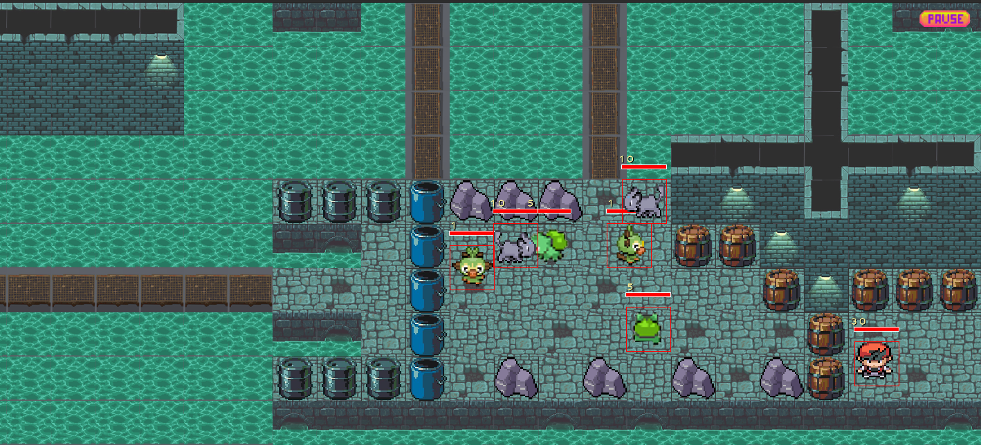
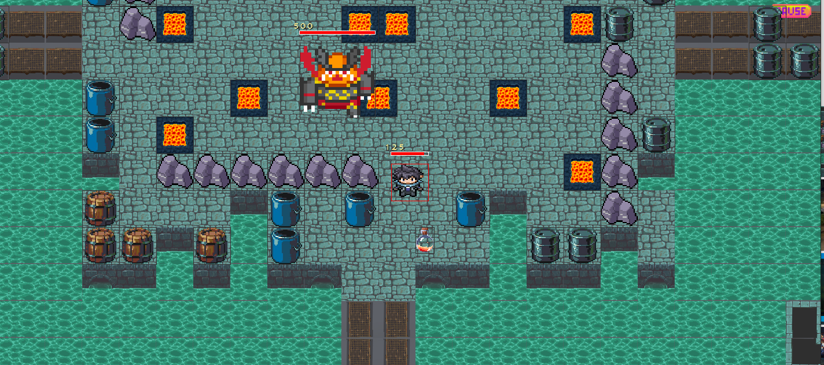
PHASE
Phase 1
Phase 2
Phase 3

Slide 7
FEATURES, MECHANISM
2

Slide 8
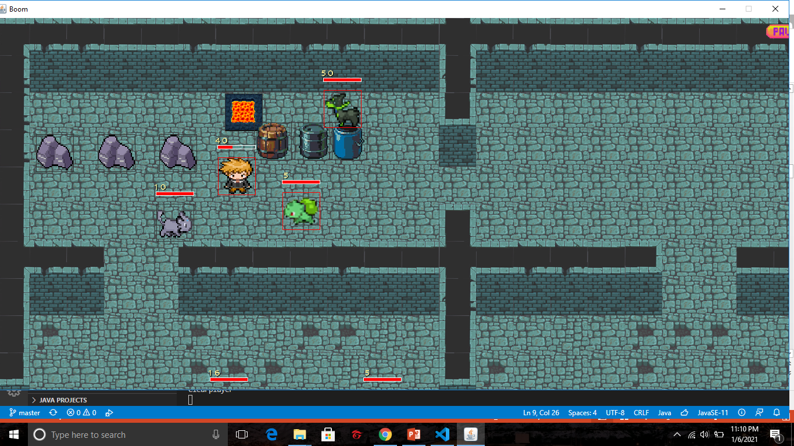
FEATURES
Players
Monsters
Items
Tiles
Bombs
Explosions

Slide 9
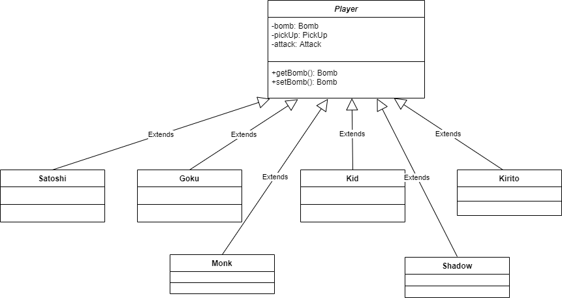

Players

Slide 10
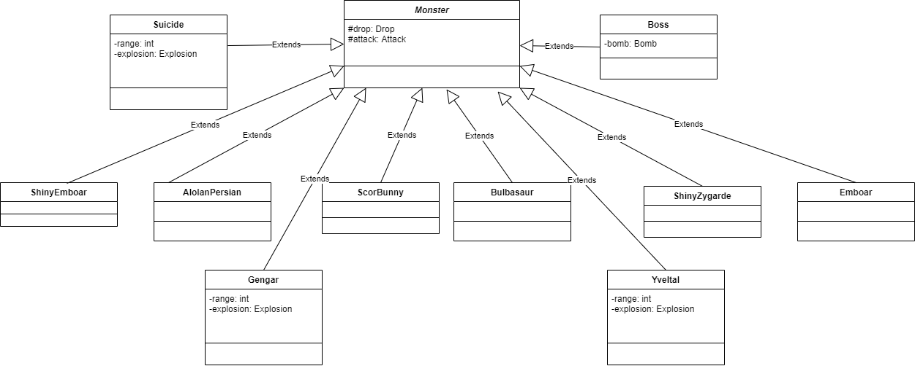

Monsters

Slide 11
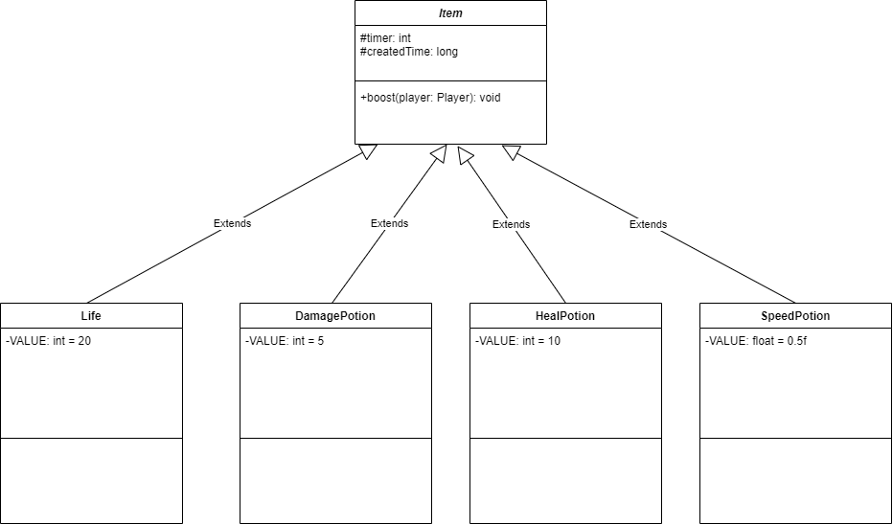


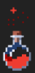
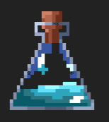
Items

Slide 12
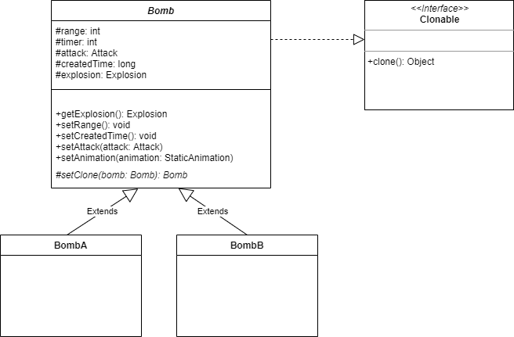

Bombs

Slide 13

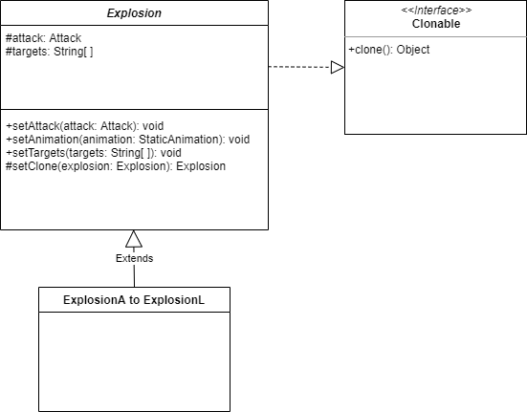

Explosions

Slide 14
MECHANISM
Animations
Collisions
Attack
Drop
Pick Up
Move

Slide 15
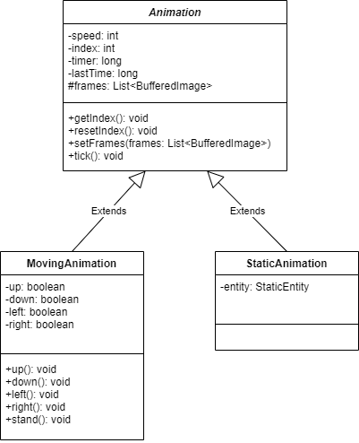
Animations

Slide 16
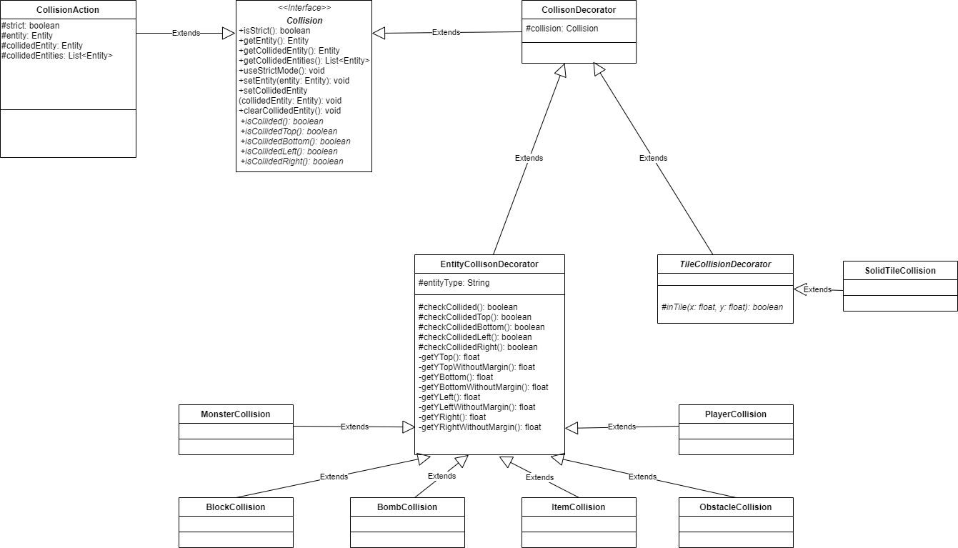
Collision

Slide 17
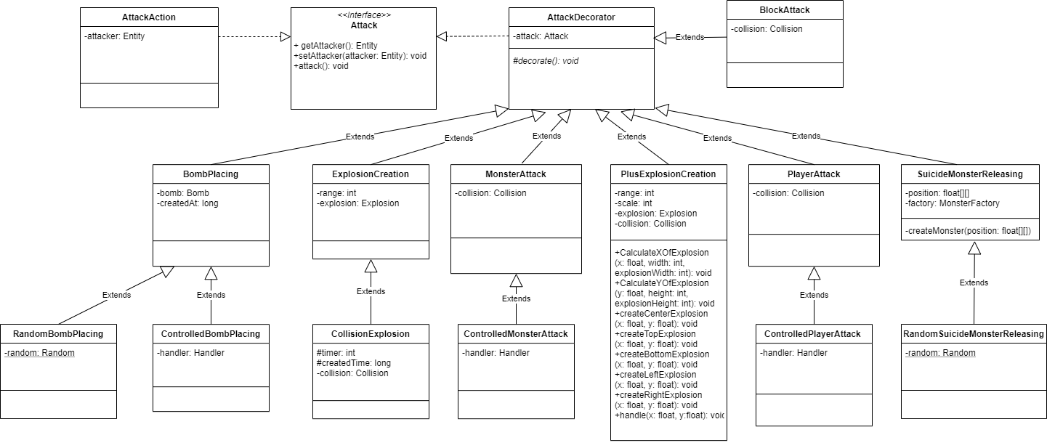
Attack

Slide 18
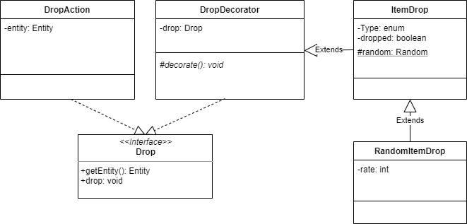
Drop

Slide 19
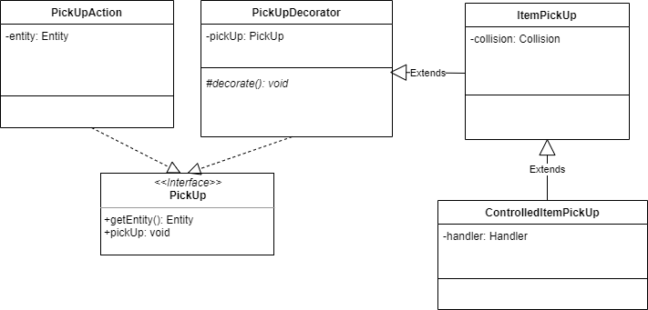
Pick Up

Slide 20
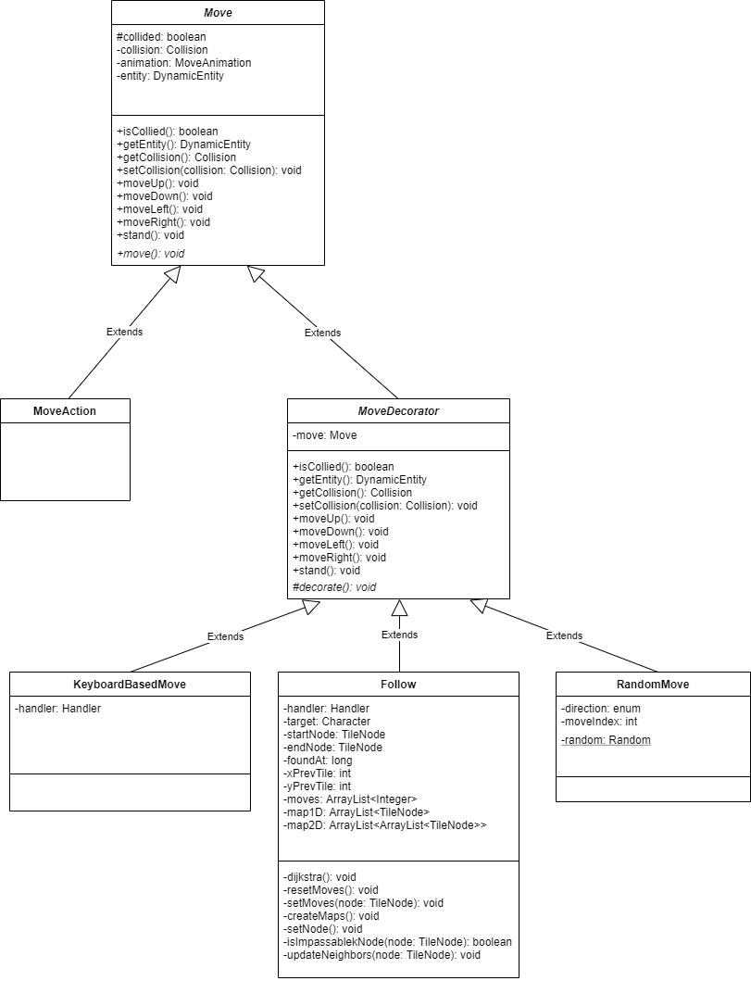
Move

Slide 21
4
Path-Finding Applying Dijsktra

Slide 22
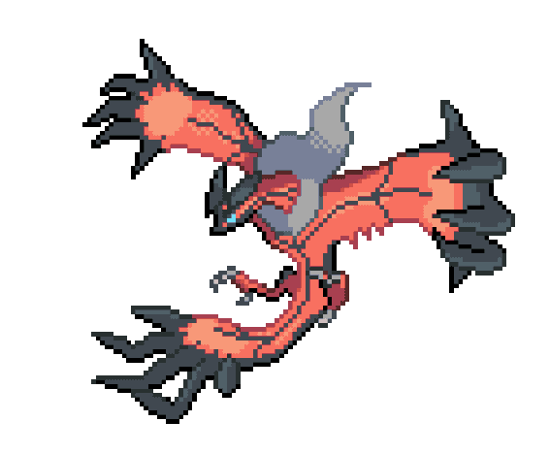
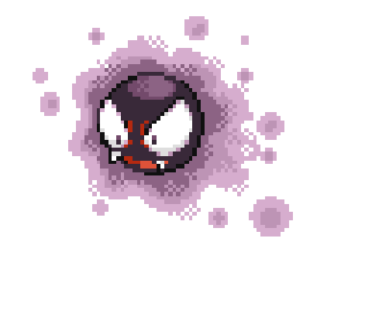
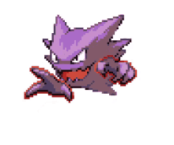

Slide 23
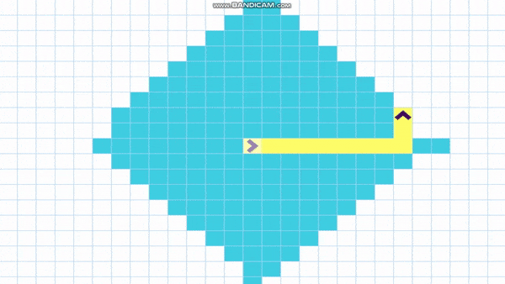
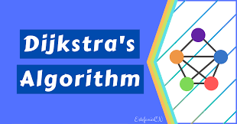

Slide 24
4
DESIGN PATTERNS, FUTURE UPDATES

Slide 25

DESIGN PATTERN
Decorator Design Pattern
Factory Method Design Pattern
Singleton Design Pattern
Prototype Design Pattern

Slide 26
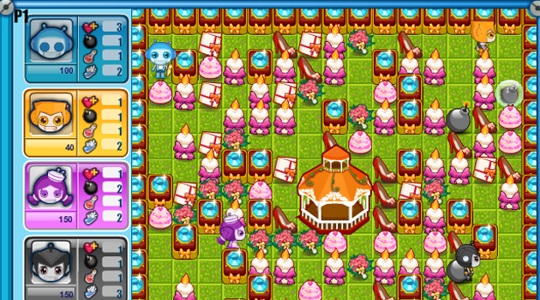
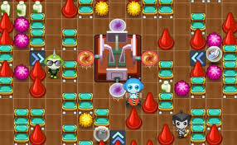
Update new features and mechanisms

Slide 27
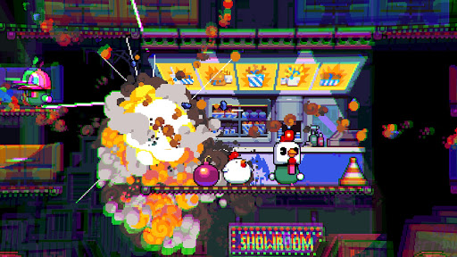
Reinforcement of Game Graphics and other Gameplay features

Slide 28
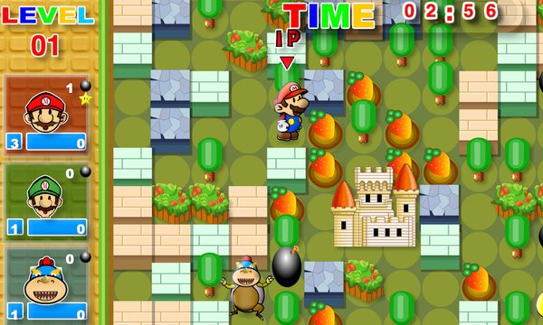
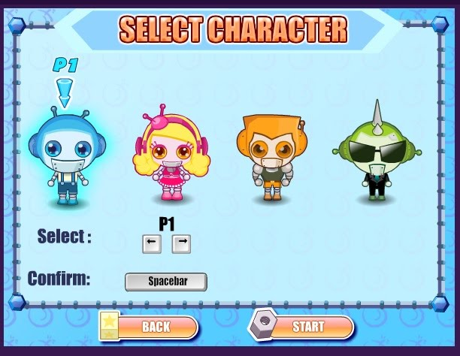
Approaching to an Online Multiplayer Game

Slide 29

GITHUB REPOSITORY, REFERENCES

Slide 30
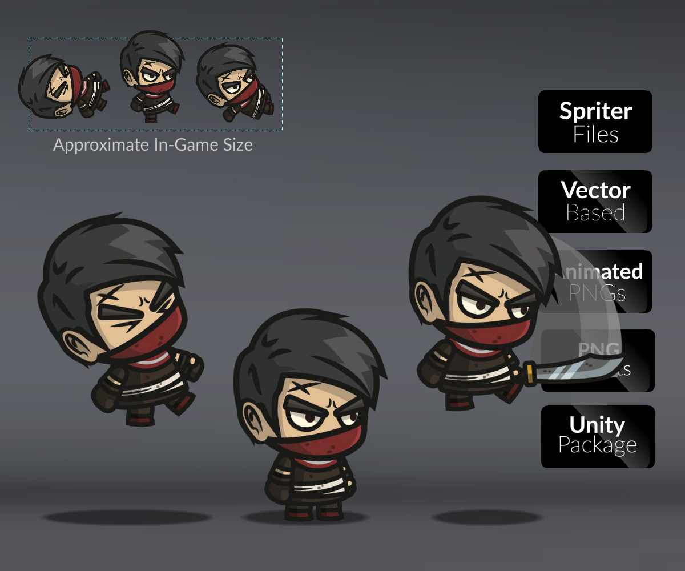

Links
GitHub Repository Link
https://github.com/TP-O/boom
Youtube
https://bitly.com.vn/e330b9
Dijkstra Algorithm
https://bom.to/QlAUlXKlWWxop
Design Pattern references
https://sourcemaking.com/
Image
https://cartoonsmart.com/

Slide 31
